Slide 1
Members
Phạm Việt Thành - 20194454
Phạm Văn Cường - 20194421
Nguyễn Tuấn Dũng - 20194427

Slide 2
Problem Statement
Physical simulation of motion.
In this simulation, the user controls a physical system, which includes three main component: main object, actor force and surface.
Main object: includes Cube and Cylinder, which the user can change their parameter such as side-length and radius, respectively.
Actor force: the actor force is applied on the center of mass of the main object, it is represented by a horizontal arrow.
Surface: The user can control the friction coefficients of the surface, which are kinetic friction coefficient and static friction coefficient.
During the simulation, the user can:
Change the magnitude of actor force and values of coefficients.
Choose to show or hide detailed information.

Slide 3
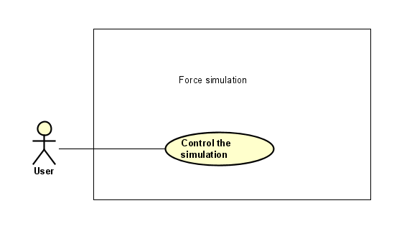
Use case diagram

Slide 4
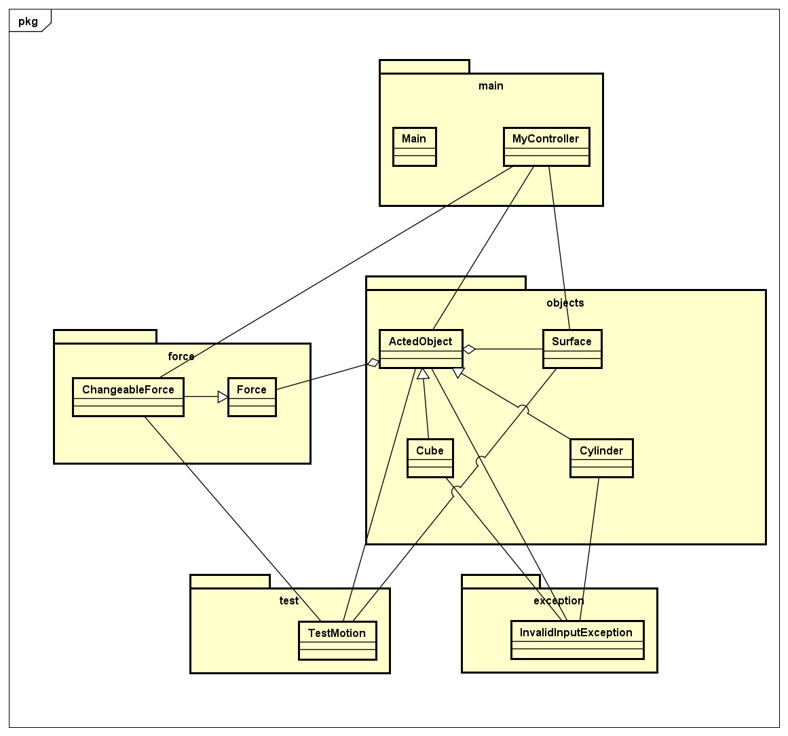
General class diagram

Slide 5
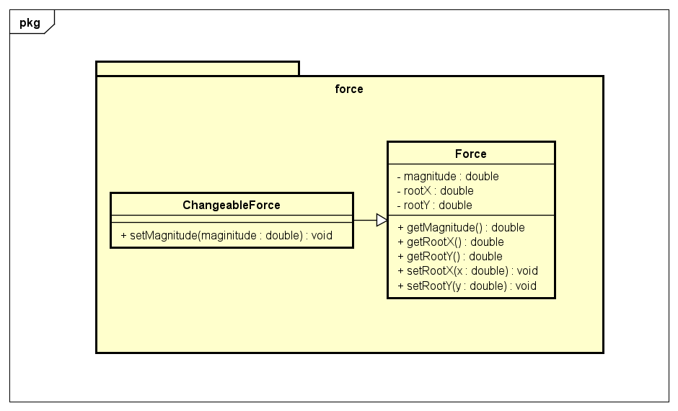
Force package

Slide 6
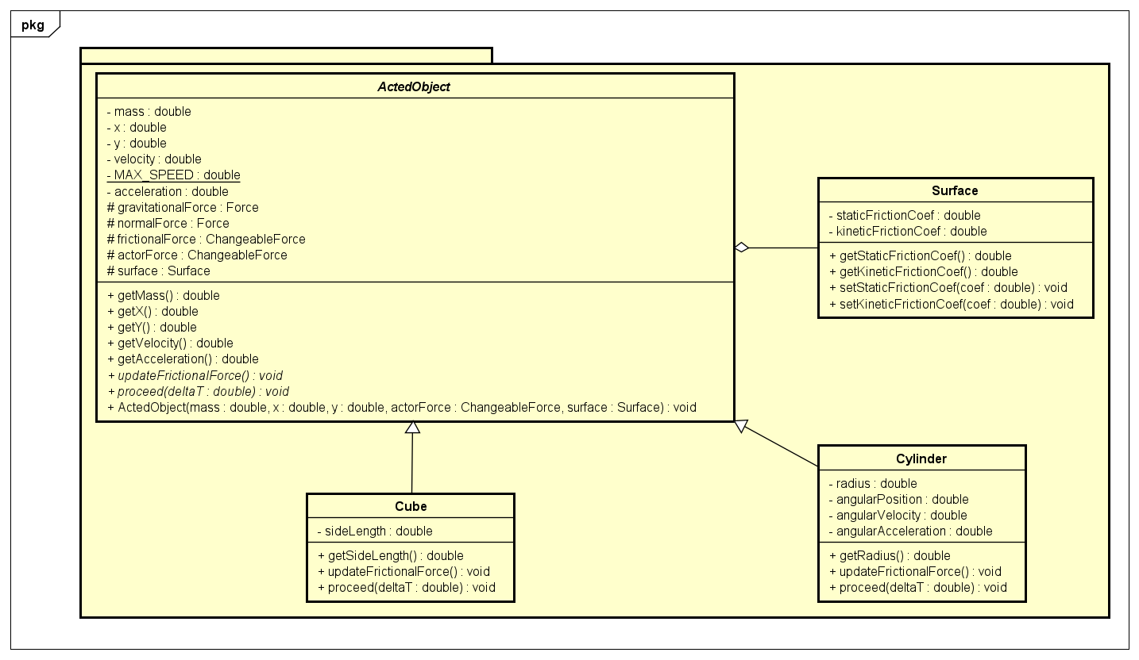
Object package

Slide 7
OOP techniques
Inheritance:
ChangeableForce inherits from Force class since it has every properties of Force except for the fact that it has a setter method for its magnitude.
Cube and Cylinder inherit from ActedObject as they share the same properties but different kinds of motion.
InvalidInputException inherits from java.lang.Exception.
Aggregation:
The main object is constantly applied by various forces, and it requires the information about those forces and the surface it’s staying on to compute its motion every now and then. Thus we made the forces and surface to be part of the main object.

Slide 8
OOP techniques
Association:
ActedObject, ChangeableForce and Surface are associated with MyController, which in turn controls the application’s GUI.
ActedObject, ChangeableForce and Surface are associated with TestMotion, which test the motion simulation functionalities.
ActedObject, ChangeableForce and Surface are associated with InvalidInputException, which is called every time an input value is invalid.
Polymorphism:
ActedObject class has abstract methods updateFrictionalForce and proceed which must be implemented by Cube and Cylinder (overriding, dynamic binding)
The system initializes a variable of type ActedObject, which will then become a Cube instance or Cylinder instance (upcasting and downcasting)

Slide 9
